Slide 1
Coursera Capstone Final Project
By Salman Shahab

Slide 2
Introduction
This project is the final requirement towards earning the IBM Data Science Professional Certificate on Coursera.
The purpose of the project is to demonstrate the use of tools and techniques learned in this data science course.
The project has to utilize the FourSquare location data via their API as its primary data source along with the other statistical data acquired from other sources such as Wikipedia.

Slide 3
Business Problem
A Mediterranean restaurant owner known for their fast food style restaurants on the East coast wants to expand their business to the West coast.
They would like to identify a location around Los Angeles County to open their first upscale restaurant and bar.
This will not be a fast food type restaurant but a full service sit-in dining experience.

Slide 4
Criteria
The place must meet the following criteria:
Take into account the higher price point at which the restaurant would operate, it must be in an upscale location.
Must have low crime rates
Must be near entertainment and shopping malls to gain more visibility and foot traffic
There should be no other Mediterranean restaurant within a 2 miles radius
We will use unsupervised machine learning to create clusters of cities or areas in Los Angeles County that will provide us the insight to pick the right location.

Slide 5
Data Requirements and Sources
List of cities in Los Angeles county and their geo coordinates
Cities demographics including per capita income, populate and crime rate
Venue data such as restaurants types, ratings, etc.
List of cities:
List of cities in Los Angeles County, California - Wikipedia
Cities demographics: (Population and income)
https://en.wikipedia.org/wiki/List_of_California_locations_by_income
Crime rate by city:
https://en.wikipedia.org/wiki/California_locations_by_crime_rate
Venues data: Foursquare
Geo coordinates: Python Geocoders library

Slide 6
Methodology
Step 1: Data will be acquired from Wikipedia as HTML tables and saved into CSV files for further processing. This will be done using Pandas Read function.
Step 2: The acquired datasets (data frames) consisting of Cities demographic data will be consolidated into one single data frame. The resulting consolidated data frame will contain city name, population, per capita income, and violent crime rate.
Step 3: All rows with county other than Los Angeles will be removed from the data frame.
Step 4: Add geospatial data to the data frame using the Nominatim function in the Conda-forge Geopy package.
Step 5: Using the Folium package, create a map of cities in LA County.
Step 6: Using Foursquare API, retrieve data for all restaurants within 1 mile of each city. This will include the restaurant categories, such as Chinese, Indian, Middle Easter, Mediterranean, etc.
Step 7: Transform the data frame with restaurant venues/categories to one-hot encoding (0/1).
Step 8: Use grouping to show the frequency of each restaurant category in each city.
Step 9: Using the info from step 8 above, create a data frame with most common restaurant categories for each city.
Step 10: Use silhouette score to identify the optimal number of parameter for the number of clusters.
Step 11: Using the silhouette score for number of clusters, run a k-means clustering algorithm (unsupervised learning) from the Scikit-learn package.
Final Step: Review the clusters to pick the one with most venues and make recommendation to client

Slide 7
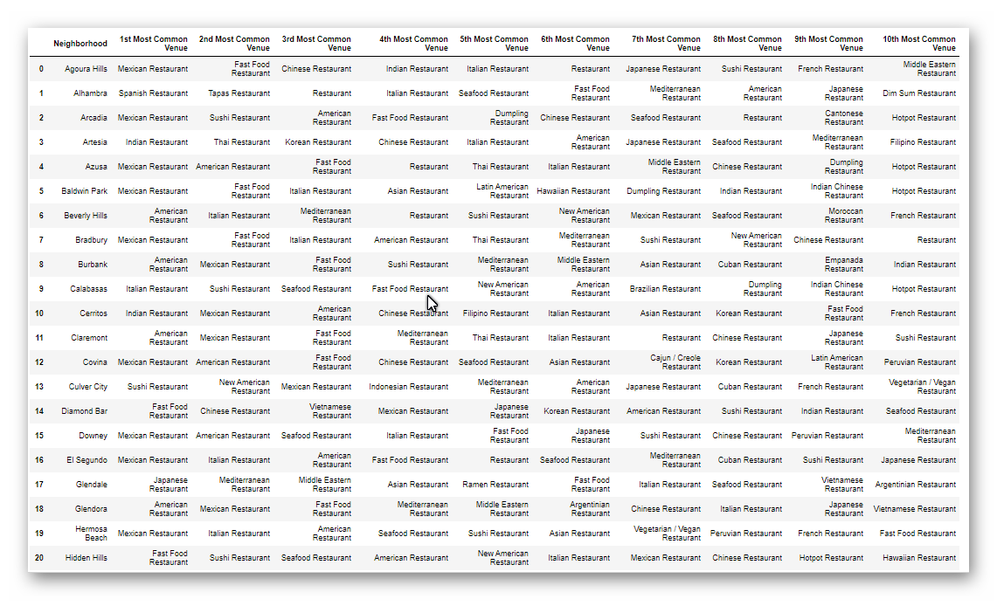
Results

Slide 8
Discussion and Conclusion
Based on the chart above, the best place to have a Mediterranean restaurant is in the city of Agoura Hills, CA which has coordinates of 34.147910, -118.765704. It meets client’s criteria for a neighborhood who lowest crime rates, higher median income and no competing restaurant in the vicinity.
This is because it has the highest median income, low crime rate, and has no other Mediterranean restaurants in its vicinity.
For the future, another variable that could be added is population in order to give us additional insight.

Slide 9
Link to Notebook
https://dataplatform.cloud.ibm.com/analytics/notebooks/v2/6c5f3210-437a-4476-af1a-7041d543d521?projectid=5edb56c5-477f-4b3a-8e42-2df03f09180d&context=cpdaas

